Slide 1

Quantifying the Pressure of Legal Risks on Third-party Vulnerability Research
Alexander Gamero-Garrido, Stefan Savage,
Kirill Levchenko and Alex C. Snoeren
Notes:
OUT: There is tension between vulnerability researchers and product manufacturers
WE ARE EXCITED ABOUT THIS
Find things that I think are exciting and summon some emotions.
Slides 7-9
Deliberately focused on the instrument. Sentiment that we uncovered. Emphasis; 50% more people that
DITCH THE U-SHAPE
******************************
Qs to address:
WHY LEVENE TEST
WHY DOES THIS MATTER GIVEN DMCA EXEMPTION
Don't say for the past two years
1. The chilling effects are beyond the DMCA (other statutes), questions of companies
2.
COmpanies that have said policy
20% that said it's ok.
What
Employees could not have connection to research – could that impact how they responded
Intent of survey takers – were they malicious?
Levene on the raw or on the average distribution
Vulnerability policy
**** NEW FEEDBACK
There is this tension between the people who find truth. And companies that get harmed. For companies that are inconvenienced by these truths; they have a range of legal tools.
Talk will be introduced. Do not repeat the title. Start by explaining what you mean. I'm from UC San Diego, where my advisors Stefan, Kirill and Alex.
Vulnerability research is different from other research. Potential for creating a conflict. You're finding a flaw, in a commercial enterprise's product. Once you're doing vulnerability research the law gets involved. Yoshi "if you're not talking to lawyers you're not doing real vulnerability."
Vulnerability research creates tension between the researcher and the company. Flaw does brand damage. Legal tools company could choose to pursue litigation
Cease and desist are not a part of typical research. What effect is it having on our community.
Perhaps the Felten case. Anecdotal example is happening.
We're trying to address the tension between brand owners...
10000 foot stuff
Typeface and change and all caps. Use white background. Who are the colleagues -- faculty at UCSD. Traditionally paper title is the talk. Use paper title. Listed in the program as that.
Don't thank the sponsors
Needs to be some more. Why are we here -- there is this tension (community is supportive). Question that has been controversial. Tension between vulnerability researchers and companies that put them forward. Very visual example of...
2-3 slides puffing up the issue. Grab headlines about people getting sued. Hit about the story they have herad about. Cisco cutting talks at blackhats.
When the chilling effect has been brought up companies say its anecdotal. Why did we bother study this thing. OH THAT'S RIGHT SOMEBODY FINALLY STUDIED THIS
Need to know the background on the case.
Pull out citations. SBA or Motor Vehicle. Take their quote. EFF quote. We got these two opinions.
--All the classes of things that can happen. Bunch of things that happen to a commercial product. Anti-circumvetion DMCA. CFAA if it's a server. Authorized access. Wireless ECPA and the Wiretap Act. Forbidden to reverse-engineer.
--Need to make them get it. Example of a threat letter.
--Examples that support the story; not China.
--Three slides from fodder -- things that can happen to you -- slides about the answer.
--You can answer the question on factual responses or perception; in this space perception matters as much as factual evidence (if researchers don't even ask it doesn't even matter).

Slide 2
Tension Inherent in Commercial Product Research
Software Manufacturers and Vulnerability Researchers
Many vulnerabilities are found by third-parties, after software ships
  Companies carry brand damage and bug-fixing cost
  Inconvenient fact-finding may lead to adversarial relationship
Manufacturers have range of legal tools to deter researchers
Do legal pressures chill vulnerability research?
Notes:
OUT: these concerns are far from abstract
TITLE SHOULD BE THE LAST BULLET
FIRST-SUB BULLET COULD BE THE TITLE.
GET RID OF FIRST FLAW-FINDING.
There's a bunch of vulnerabilities in software.
End with the title -- start with background
Slate article written Felten -- "The chilling effects of DMCA"
The BSA is a trade group.
*************************************
Third-party vulnerability research is important because – first bullet
You need to start with a sentence or two motivating why it is valuable to have 3rd party vulnerability research at all.
That kind of wraps it up—need a better segue.

Slide 3
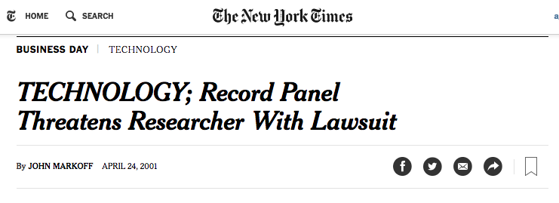

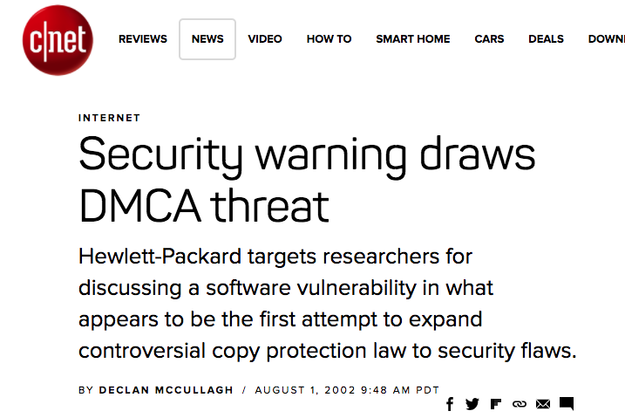
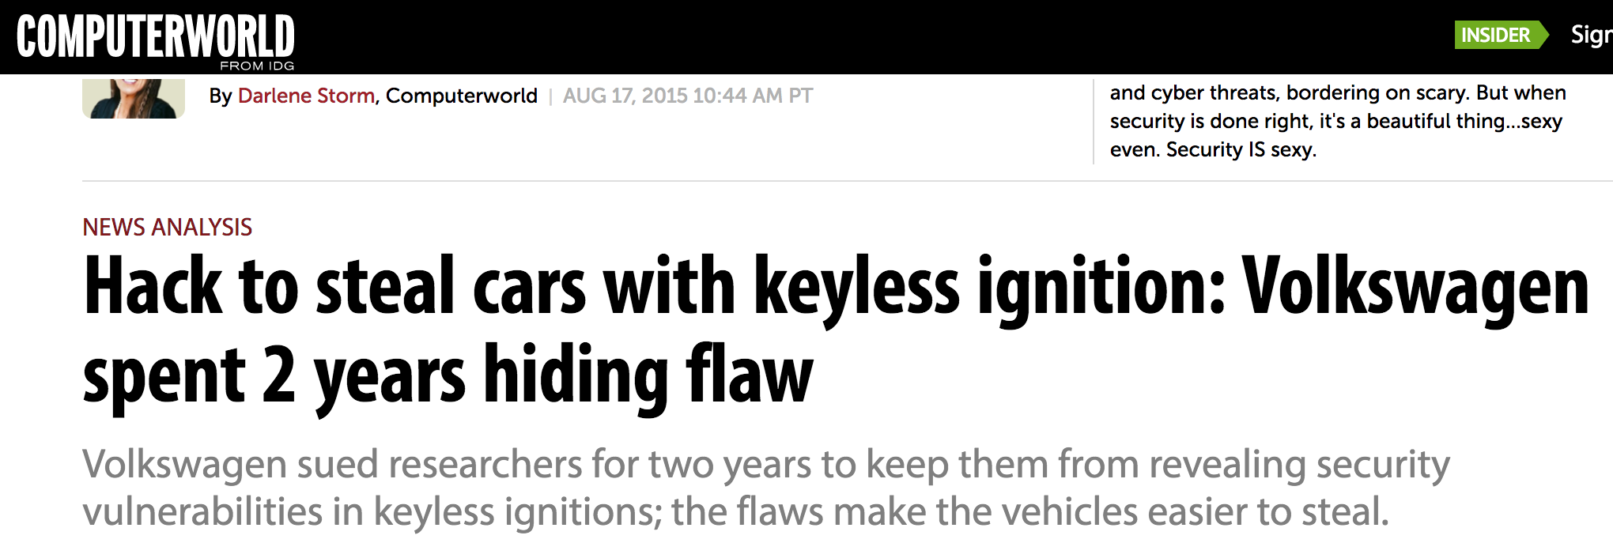
Notes:
OUT: The anecdotal nature of these incidents has led to two separate policy camps regarding the potential for chilling effect of such threats on vulnerability research
Get rid of previous chain picture. Slate article. Look but there's more.
Remove TEXAS
MORE RECENT HEADLINES
SLIDE TWO IS THE ONE WITH THE TENSION
Maybe make this slide 2.
We didn't limit to companies that were US actors,
EFF pulled out of the W3C. Look through EME -- encrypted media extensions. DRM in the browser. Clause protecting researchers didn't make it in, EFF pulled out.
****
Paper withdrawn. This affects our community. Felton is a well-known case, but there are others.
Start with Felten example, then say there are others
Navigate it at a much higher level.
2-4 ONE SLIDE
Researchers from our own community had to pull a paper from the venue.
Best known from this community. There've been a number of these cases. Example of it. LESS IS MORE.
Research result found a flaw in a commercial system. Company who owned the intellectual property threatened; withdrew
----- Meeting Notes (11/1/17 00:20) -----
`

Slide 4


Public Positions on Chilling Effect Hypothesis
“The DMCA Chills Free Expression and Scientific Research”
“These developments weaken security for all computer users”
“… very little in the record to demonstrate that researchers are currently declining to engage in good faith security testing”
“… software companies already have in place carefully tailored processes for working with independent researchers”
Notes:
IN: one camp is represented by the Electronic Frontier Foundation, a strong proponent of the chilling effect hypothesis
OUT: in order to ground this debate using evidence, we designed these instruments and research questions
Second quote has an orphans. GET RID OF SECOND QUOTE.
BSA -- flip the order of the last two quotes.
No need to read the quotes. PARAPHRASE.
This is not stopping chilling effect from happening.
One side is saying there is chilling effect. Down to earth statement
Religious argument driven by rhetoric. We wanted to measure it and provide evidence.
****************************************************
his is the more important slide.
These are quotes. Quote marks... elipsis... "I've been at CAIDA too long I don't use upper cases."
Example of the tension. Segway to the questions. Visually.
Chilling effect hypothesis STATED
Software companies say they have tailored. We look at this question in the second part

Slide 5
Research Questions and Instruments
Do legal concerns chill vulnerability research?
  Survey
When asked, do companies explicitly allow third-party research?
  Experiment
Notes:
IN: to measure if legal concerns chill vulnerability research we designed a survey targeting researchers
OUT: the first part of this talk will explain how we designed the survey and what we found
GET RID OF WHEN ASKED
WE DID AN EXPERIMENT, WE ASKED THEM
MAKE QUESTIONS BIGGER
KNOW EXACTLY WHAT WE'RE GONNA SAY.
FOCUS ON THE QUESTIONS/SCIENCE.
Lead with the questions --
*****************************************************
Smoother transition from previous slide.
More succinct. Shorter version.
"Do researchers not engage in research following legal threats" (Asserted by EFF)
"Do software vendors support third-party vulnerability research" (Asserted by BSA -- is this true)
Overview summary -- THIS IS WHAT WE DID
Two measurement instruments:
1 ANSWER FIRST BY SURVEYING THE TARGET POPULATION
2 TESTED COMPANIES
slides before
Warmup. At the end of the warmup these are the two questions. Popular topic -- he said she said.
Fix page number
ALL CAPS. Make sure the colors are robust. REVERSE ORDER.
Flip these questions.
Editorialized the quotes -- in the back third. Could be wrong.
People are worried -- this is what we found.
Don't make the first ONE QUESTION DISAPPEAR.
Do not say we focused on the DMCA.

Slide 6

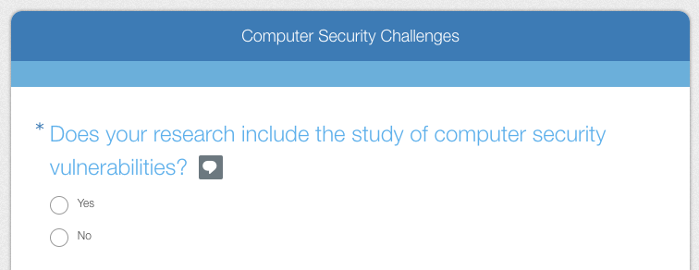
Researcher Sentiment Survey
Sent recruiting message to 1,369 individuals
Final sample, n = 110
Notes:
IN: we found our target population to send our recruiting message on seclists.org, an archive of vulnerability-related mailing lists, specifically, Daily Dave and Bugtraq
OUT: once the respondent had self-identified as a vulnerability researcher,

Slide 7
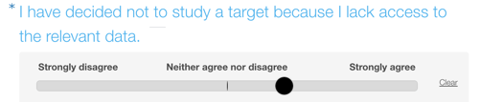
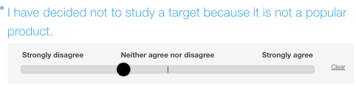
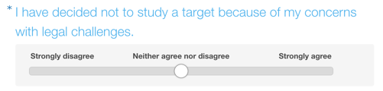
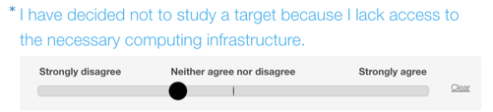
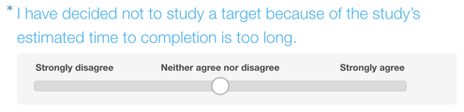
“Concerns with Legal Challenges” as Research Impediment
Notes:
IN: we were interested in measuring whether or not “concerns with legal challenges” was singled out as an impediment to research
OUT: we included four distractors for calibration, and wanted to see if concerns with legal challenges was singled out as an impediment to research

Slide 8
Notes:
IN: we were interested in measuring whether or not “concerns with legal challenges” was singled out as an impediment to research
OUT: we included four distractors for calibration, and wanted to see if concerns with legal challenges was singled out as an impediment to research

Slide 9
Legal Challenges is Different From Distractors
Distractors
Legal Challenges
Hypothesis: raw distribution of legal challenges is different from each distractor
Levene: raw distribution of legal challenges’ variance is different than distractors
Percentage of Participants
Neither Agree
nor Disagree
Strongly Disagree
Disagree
Agree
Strongly Agree
Notes:
IN: in particular, we wanted to measure a statistical difference between the distribution of legal challenges compared with the distractors
OUT: in order to formalize the comparison for each bin, we can zoom in to the difference between concerns with legal challenges and the combined distractors for each category
Underlying distributions -- means to an end. The blue bar is the underlying "agreeability."
Percentage. is easier to talk about
26% of the respondents strongly agree that this is a concern. SHOW THE TRACKING VARIABLE FIRST
Security researchers are a brazen bunch. Distribution for arbitrary concern. Relative differences.
Agreeable bunch mainly agreed, they strongly agreed with legal chanllenges. Agree + strongly agree. 40% or researchers agreed with legal challenges. For ca
Many more change for number of more
Why is there a lot of strongly disagree as well!? Compare to minority of other issues
#########
Participant had to click in order to signal neutrality with a statement, or move the slider left to signal disagreement, or move right to signal agreement.
As a matter of methodology -- distractors so they wouldn't know what we're looking for. Asked a bunch of other questions to clarify -- control with the distractors
Something that show visually that we don't care about the other questions, highlight tracking variable
Zoomed in first -- to tracking variable -- zoom out to 5 questions

Slide 10
How is Legal Challenges Different From Distractors?
120%
90%
60%
Difference in #Responses,
Confidence Interval
30%
0%
-30%
-60%
Neither Agree
nor Disagree
Strongly Disagree
Disagree
Agree
Strongly Agree
Notes:
IN: Here we keep the same horizontal axis with level of agreement, in grey we show the difference in number of participants in each category, comparing legal challenges to the average of the distractors
OUT: We were also interested in eliciting subjective responses related to their perception and experience with legal action
CHANGE INTO PERCENTAGE ONCE I DOWNLOAD THE FILE
DRAW line around grey boxes. THICKER LINE AT ZERO. NO NEED TO SAY SUPPORT OUR STATEMENT THAT -- THE FACTS SUPPORT THAT PEOPLE STRONGLY AGREE WITH LEGAL CHALLENGES
Participant had to click in order to signal neutrality with a statement, or move the slider left to signal disagreement, or move right to signal agreement.
As a matter of methodology -- distractors so they wouldn't know what we're looking for. Asked a bunch of other questions to clarify -- control with the distractors
Something that show visually that we don't care about the other questions, highlight tracking variable
Zoomed in first -- to tracking variable -- zoom out to 5 questions

Slide 11
Consequences of Fear of Legal Action
Have you ever feared legal action as a consequence of your research?
26%
Modified a research project as a consequence of fear of legal action
Notes:
IN: First we asked them if they had feared legal action as a consequence of their research
OUT: We also wanted to know how many participants had experienced actual threats

Slide 12
Experience with Actual Legal Threats
Have you ever been threatened with legal action as a consequence of your vulnerability-related research?
22%
Reported being threatened with legal action
Notes:
IN: and we asked them how many of them had experienced it
OUT: We again gave participants the opportunity to expand on their experience

Slide 13
Threatened
with Legal Action
26%
Modified a Project as a Consequence of Fear of Legal Action
22%
Direct Effect
Chilling Effect
58% of respondents who modified/canceled a project because of fear of legal action
Have never been threatened
Notes:
IN: This is not only an issue for those who are directly threatened
OUT: WE GAVE PARTICIPANTS THE OPPORTUNITY TO EXPAND ON THEIR EXPERIENCE IN A FREE-TEXT BOX
THAT'S A BETTER INTRO. Effect goes beyond direct legal threats.
NEW FACT -- explain.
Show the 22 as 22 instead of 78. DO NOT ANIMATE THE VENN DIAGRAM. QUOTES ARE LAST AS A VICTORY LAP.
DIRECT EFFECT VS. CHILLING EFFECT.
**************************************
Start with 78% of the people
Highlight the inbetween -- as a separate thing. Animate initially they're separated.
Pop out -- more people modified out of fear THAN PEOPLE WHO WERE THREATENED
More than half the people who
Bar at the top, what fraction from each circle in the intersection
REPLACE WITH VENN DIAGRAM

Slide 14

Consequences of Fear of Legal Action
“We removed the relevant research files from our group site”,
“[I] destroyed my notes, and did something else”,
“I sat on a vulnerability for a decade”
Notes:
IN: these are some of the comments they shared with us, showing the consequences of their fear of legal action
OUT: we also wanted to know how many of them had experienced legal action personally
26%
Reorder survey
‘We asked the question in a different way
Show EFF quote again – 26 % were threatened with legal action. Some other people were threatened.
How many people modified, and how many were threatened
Venn diagram – in the middle put number or percentage
People who changed their behavior even though they weren’t actually threatened
Show the question on top (form from SurveyMonkey) and th
26% have claimed that they felt the chilling effect. BIG RESULT. Don't interpret -- use the question from the survey.
Fear but there is some factual basis. Of the people we surveyed. EXPLAIN HOW WE CHOSE THEM. FIND ALL THE RESEARCHERS WE COULD. By no means representative of all researchers ever but these are the one we could find. Put the numbers up -- we sent 1400 emails.
Use as motivation for the second half of talk. Didn't disclose to
We asked participants if they had ever feared legal action, and those that answered yes were asked if they had modified a research project as a consequence.

Slide 15
Experience with Actual Legal Threats
“…[received] e-mails with veiled legal threats, citing violation of licensing terms and conditions”
“… contacted by the manufacturer’s legal team and threatened with multiple lawsuits... [including threats of] arrest for violating 18 USC 1030”
Notes:
IN: these are two of the comments they shared with us
OUT: we summarize out survey findings in the next slide

Slide 16
Researcher Survey Summary
Legal challenges singled out as deterrent of vulnerability research
  25% strongly agree legal challenges are impediment
  Significantly higher rate of strong agreement compared to other impediments
26% of respondents have modified a project as a consequence of fear
22% of respondents have been threatened with legal action
Notes:
IN: Recall that legal challenges was singled out as a deterrent of vulnerability research
OUT: “Perhaps the researchers are shy, they could always just ask permission”

Slide 17
Company Authorization Study
“… software companies already have in place carefully tailored processes for working with independent researchers”
    Can researchers obtain research authorization from companies?
      Written permission would shield researchers from civil litigation
      Anecdotal evidence: these requests are not widespread
Experiment
Real security researchers sent companies requests to evaluate their products
    Two U.S. academics
    one U.S. independent, one E.U. independent
Notes:
IN: as stated by the BSA and other trade groups, we wanted to see if this mechanism was available to researchers
OUT: The actual text of the initial request we sent to companies is shown in the next slide
What happens if they ask for permission?
***
Bring back the quote from BSA as the transition
See how easy it is to elicit processes
Set the record straight

Slide 18
Request Sent to Companies
Dear [RECIPIENT NAME],
My name is [REAL NAME] and I am a security analyst at [REAL ORGANIZATION], one of the nation’s leading institutions working on cybersecurity and vulnerability analysis. Currently, my team is investigating vulnerabilities of computing devices, and we would like to include your product [REAL PRODUCT] in our tests. This email is a formal request for permission to evaluate, alter, and potentially circumvent security mechanisms of [REAL PRODUCT] for legitimate research purposes.
Should you have any questions regarding this request or the nature of our research, please contact me or browse our recent publications at [REAL WEBSITE].
Sincerely,
[REAL NAME]
[REAL TITLE AND ORGANIZATION]
Notes:
IN: here is the text of the initial email, all initial contacts included very similar language
OUT: who did we send this request to?
To do this – this is what we sent. Make GREY LESS GREY. Needs much more explanation. Dove into the HOW without any discussion of the why. Actually get at the real truth is to run the exercise.
--Subset of the population object to the ethics. Aware of the imposition of the study. Why is this the only way to know the real truth.
--It's going to be complicated depending 0n who asks.
--Text if you want them to read it, highlight the key sentences. Take out the DMCA thing. (Maybe put it in the results).
"This email is a formal request. 60-minute style to blurr or light gray."
The pictures could be a trigger. The one on the right is a trigger. Conscious decision to have the pictures
Why is this a valid thing to do -- gives you legal harbor.
Freeform conversation is the ACTUAL REASON for not going to phone calls.
DO NOT HIGHLIGHT rejected.
Why do we differentiate between independent than academics --
DO NOT ASK AUDIENCE QUESTIONS
Setting based on anectodal understanding that academic researchers benefit from prestige of host university, “optics” of public mission, and legal counsel
Independent security researchers may have little to no institutional support
HARMONIZE TYPEFACE
Image source:
https://pixabay.com/en/photos/professor/
http://www.prophethacker.com/2016/04/10ways-look-like-a-hacker.html

Slide 19

Company Selection
Sold electronics or software (not just services) to individual U.S. consumers
120 Companies fitting these criteria. We tested 75, chosen at random.
Targeted a senior technical employee found on LinkedIn to request appropriate contact
Combined revenue of sample is $1.5 trillion, or 8% of U.S. GDP
Notes:
IN: we wanted our sample to be a meaningufl share of an industry, so we limited the selection to companies who sold electronics or software in the U.S.
OUT: next silde will give you a sense of the effort required on the part of the researchers,
HOW DID WE SELECT THE 75 COMPANIES
Role of the respondent, was to give us a contact.
Image from https://www.google.com/url?sa=i&rct=j&q=&esrc=s&source=images&cd=&cad=rja&uact=8&ved=0ahUKEwi1ppDK3ebWAhUhqVQKHfqaDXIQjhwIBQ&url=https%3A%2F%2Ftechhub.osu.edu%2F%3Ffield_major_tid%255B%255D%3D194%26field_usage_tid%255B%255D%3D195%26field_display_size_inches_value%255B%255D%3D15%26field_operating_system_tid%255B%255D%3D38%26field_device_storage_value%3D3&psig=AOvVaw2HeYt6jisXvRrOLX4THj5W&ust=1507748110090465

Slide 20
Researcher Outgoing Communications and Effort
Researchers sent 220 messages
Sent two follow-up emails to each unresponsive contact
Most unresponsive companies also received a letter by regular mail
Commitment of up to 8 months, only 20% of requests granted
Interaction Length (days)
Notes:
IN: this timeline shows the length of each interaction between the researcher and the companies, horizontal axis goes from 1 day to nearly 8 months, and each of the 36 responsive companies are shown on the vertical axis
OUT: in the next few slides we will dive in to the classification of responses for the companies in our sample
We don't care about the interval.
Why is this
animation???
We sent multiple follow-up emails. WE WERE PERSISTENT. Separate slide shows the process. Effort that went into badgering the people.
******************************************************
Response time ranged from same-day to nearly eight months
Need to motivate the response graph. No point in having a graph build without describing what’s going on. Need to explain the colors of what the graph are, as well as what you were doing at the time.
What is the point of this graph??!!
What is the point of the slide.
Median response time was 37 days
Over 220 messages sent to companies
MAYBE INSERT TIMELINE CHART
HOW MANY COMPANIES IN SAMPLE
How many companies are willing to do what BSA says they are willing to do.
Here's survey responses for tracking variables
ARE BSA MEMBERS
Lost the discussion about the goal of the survey
Emulate the process -- get MOTIVATION back here
Huge quantitative. distinction.
Lost timeline -- say that this sometimes took 9 months. Summary median time is 3 months, median number of interactions.

Slide 21
Response Classification: Results and Examples
Granted: explicitly granted the request
  “When investigating a vulnerability, please, only ever target your own accounts and products.”
  “If you guys are interested in buying a targeted product on a discounted price...”
Unresponsive
  We did not hear back even after postal follow-up
Rejected: explicit rejection of our request
  “After careful consideration, we have made the decision to decline your blanket request to waive the rights afforded to Company under the Digital Millennium Copyright Act.”
Indeterminate: the conversation seemed to be productive, but then dropped off and we were unable to re-engage
  “We are always happy to work with security researchers. Let me know what I can do to help. I’ve included...our CTO on this, as well as...who runs our mobile group. The three of us are...responsible for security of Com- pany’s products. “
Notes:
IN: these slides will explain our classification and also show our results
OUT: now that we have built the categories we can display one of the main findings of our study
We sent another message -- great, can we talk?
We should not expect the researcher to do more than we did here.
GET RID OF HORIZONTAL PERCENTAGES
ADD n to academics. Then label percentages.
granted - rejected - unresponsive - indeterminate
******
Gray and the gray can merge easily with slight projector change
Indeterminate and unresponsive are very hard to tell apart.
Box is gone -- independent is left.
Drop each box and say examples. Free space on.
NORMALIZE.
THEN SHOW ONE BLOCK AT A TIME
WRITE PERCENTAGE ON THE BAR – THIN NUMBER. HELVETICA LIGHT.
Indeterminate: could fall into either category.
Reverse granted and rejected. Granted on the RIGHT.
New commanication modality -- the Power Point. Build up and spend time digest it.
Statistically significant -- GET IT RIGHT. Or don't go there. Put the NUMBER OF SAMPLES. NUMBERS OR PERCENTAGES INSIDE THE BOXES.
"Click trajectory talk -- box. Tristan's talk"
This difference is statistically significant: academics are more likely to have their request granted than independent researchers.
Academics were the only ones to have requests explicitly rejected, we suspect that this is because academics were more likely to be able to engage with the company; most independent requests received no response despite multipe attempts

Slide 22
Affiliation of Researcher Affects Response
Notes:
IN: academic researchers are significantly more likely to receive a positive response from companies
OUT: To summarize the findings in this section
This chart excludes companies who did not respond to email only (n = 53)
NORMALIZE
THEN SUMMARY
SUMMARY
NORMALIZE HOW MANY COMPANIES IN EACH SIDE
IF YOU’RE AN INDEPENDENT IN MOST CASES ANSWER IS NO
IF YOU’RE AN ACADEMIC YOU’RE BETTER OFF BUT AT BEST YOU GET 50%
Box is gone -- independent is left.
Drop each box and say examples. Free space on.
Reverse granted and rejected. Granted on the RIGHT.
New commanication modality -- the Power Point. Build up and spend time digest it.
Statistically significant -- GET IT RIGHT. Or don't go there. Put the NUMBER OF SAMPLES. NUMBERS OR PERCENTAGES INSIDE THE BOXES.
"Click trajectory talk -- box. Tristan's talk"
This difference is statistically significant: academics are more likely to have their request granted than independent researchers.
Academics were the only ones to have requests explicitly rejected, we suspect that this is because academics were more likely to be able to engage with the company; most independent requests received no response despite multipe attempts

Slide 23
Company Authorization Study Summary
40% of companies engaged with the request
Only a fifth of companies explicitly grant permission
Academics are more likely to receive a response and get permission
Notes:
IN: most companies do not engage with the request
OUT: we will use the EFF and BSA quotes from the beginning of the talk as a narrative vehicle for the discussion
USE 20% GRANTED THE REQUEST
Go straight into disucssion

Slide 24
Discussion
“The DMCA Chills Free Expression and Scientific Research”
25% strongly agree: legal challenges are impediment to research
26% of respondents have modified a project as a consequence of fear
Notes:
IN: First, the EFF and other proponents of the chilling effects hypothesis
OUT: we can also revise the statements by the BSA, representative of detractors of the chilling effects hypothesis
Get rid of second quote. Then add second bullet with venn diagram
Not an endorsement of these companies positions, narrative vehicle to display our results
Our sample included four companies who are BSA members
This is the more important slide.
These are quotes. Quote marks... elipsis... "I've been at CAIDA too long I don't use upper cases."
Example of the tension. Segway to the questions. Visually.
Chilling effect hypothesis STATED
Software companies say they have tailored. We look at this question in the second part

Slide 25
Discussion
“… software companies already have in place carefully tailored processes for working with independent researchers”
Only 20% of companies contacted were willing and able to authorize third-party vulnerability research
“… very little in the record to demonstrate that researchers are currently declining to engage in good faith security testing”
58% of respondents who modified/canceled a project because of fear of legal action have never been threatened
Notes:
IN: BSA states companies have processes for working with independent researchers
OUT: we now conclude our talk
make text a bit bigger
After presenting numbers:
Give in sentence form – what is the claim we can make
Our sample included four companies who are BSA members
This is the more important slide.
These are quotes. Quote marks... elipsis... "I've been at CAIDA too long I don't use upper cases."
Example of the tension. Segway to the questions. Visually.
Chilling effect hypothesis STATED
Software companies say they have tailored. We look at this question in the second part

Slide 26
Conclusion
Legal risks (perception and reality) remain a concern for the security research community.
These risks may disproportionately affect the experience of non-academics.
cseweb.ucsd.edu/~agamerog
evidencebasedsecurity.org
Volunteer researchers: thank you!
Notes:
IN: Legal risks remain a concern of the security research community
OUT: I’m now happy to take any questions, thank you

Slide 27
Backup slides

Slide 28
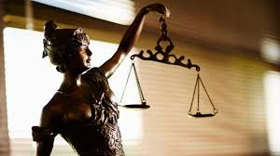
Why were companies more responsive and nicer to academics?
Perception: academics more amenable to coordinated disclosure
Legal resources: backing of university legal counsel
Worse “optics” of rejecting academic requests
Recruiting
“We are going to take one or two interns next summer in the product security group at Company. I was wondering if any of your students would be interested.”
Notes:
Image from
RATHER NOT SPECULATE. LAST ONE IS FINE. Qualitative tone to some of these responses. What are some of the concerns that the companies said. Do not editorialize. Other people use this an opportunity to recruit. We can't answer the question definitively so don't. Disparity is an open question.
https://www.google.com/url?sa=i&rct=j&q=&esrc=s&source=images&cd=&ved=0ahUKEwif5YXtucDWAhUns1QKHWKRChwQjhwIBQ&url=http%3A%2F%2Fwww.vsu.edu%2Fabout%2Fleadership%2Foffice-of-the-president%2Funits-reporting-president%2Flegal-counsel-office%2Findex.php&psig=AFQjCNEB631InV9J3HamhDkCvUzUCRLqTw&ust=1506432840070022

Slide 29
Company, Contact and product selection
Companies: Fortune 1000, Large retailers, stock indices, press lists, Y Combinator
Products: most reviewed items on amazon.com, (in limited cases) press lists
Contact employees: LinkedIn filtered to U.S. Employees, prioritizing senior technical managers. Addresses verified using free tools or probe messages.
Mail contacts: chief legal officer or general counsel.

Slide 30
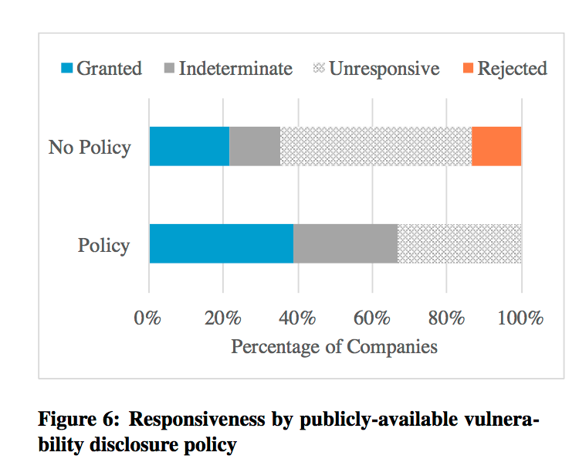
Have they thought about this before.

Slide 31
Product Categories
Product Category | Number of Devices
Smart home devices | 13
Multimedia devices | 12
Printers | 6
Tablets | 6
Wearable electronic devices | 6
All others | 32

Slide 32
Survey recruiting
Collected set of participants in publicly-available archives of vulnerability-related mailing lists
Recruiting message:
Dear Participant,
We are a group of faculty and researchers at UC San Diego’s Computer Science and Engineering Department. Currently, we’re doing a study on the challenges faced by security vulnerability researchers, and would greatly appreciate your help. Please consider filling out this short survey∗, to help us understand your experience. Estimated time to completion is 1–5 minutes.

Slide 33
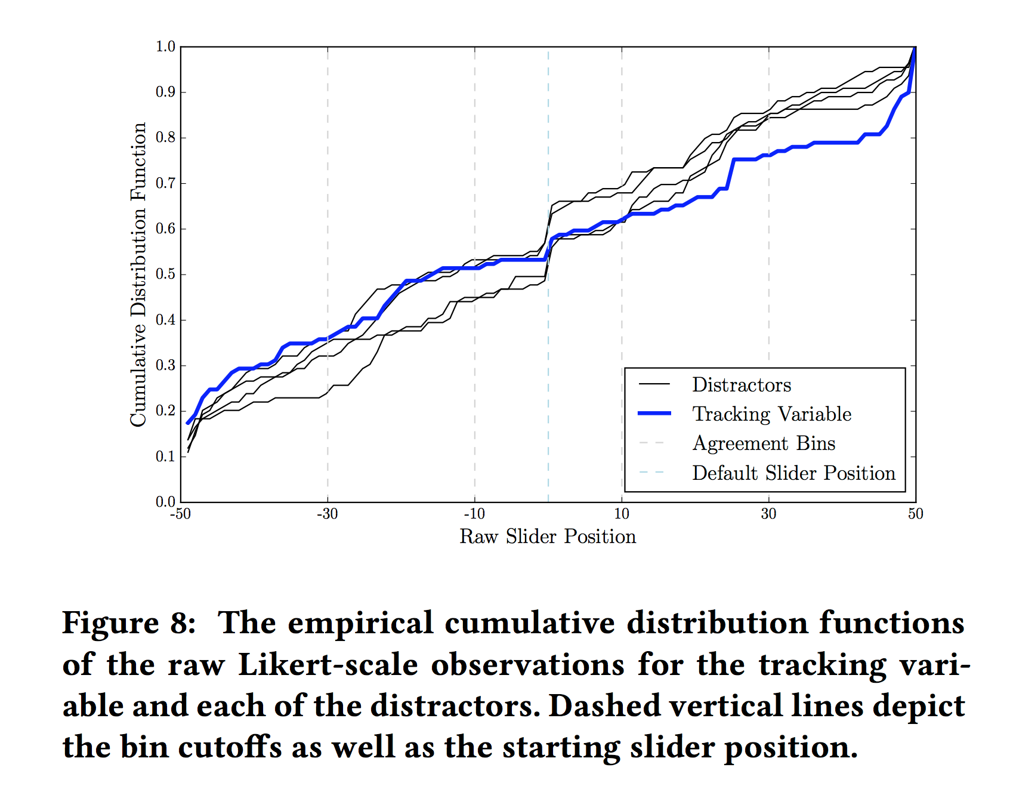
Distribution of Responses

